Slide 1

Primary Outcomes of the MOTIV BTK Sirolimus-Eluting Bioresorbable Vascular Scaffold for the Treatment of Infrapopliteal Lesions
MOTIV BTK Trial
Tim Wittig, Dr. med.
Ehrin Armstrong, MD MSc FACC FSCAI FSVM
Andrej Schmidt, Prof. Dr. med
On behalf of the MOTIV BTK Investigators

Slide 2
Disclosure
Speaker name: Tim Wittig
I have the following potential conflicts of interest to report:
  Consulting / Speaker honorarium:
    Abbott Vascular, Philips, Angiodynamics

Slide 3

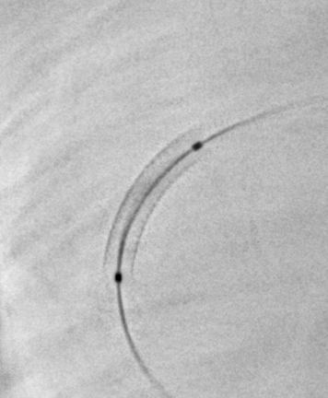
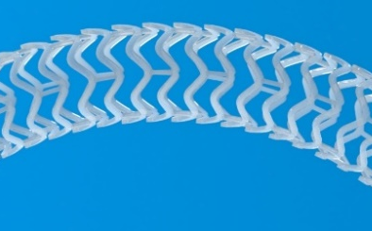
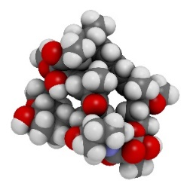
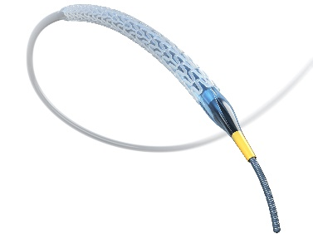
MOTIV® Sirolimus-Eluting Bioresorbable Scaffold
Scaffold Design
Tyrocore®
Sirolimus
Delivery System
Thin struts: 95 - 115 µm
Enhanced radial strength
Diameters: 2.5 – 3.5 mm (Clinical)
  4.0mm Diameter (Commercial)
Lengths 12 – 60 mm (Clinical)
80 mm Length (Commercial)
0.75 expansion over nominal (3.0 mm)
Only Radiopaque BRS
Provides strength during expansion & healing
Physiological capability restored by one year
  No resistance to expansion/contraction
Complete resorption in ~3-4 years
First anti-proliferative agent used in drug-eluting stents
Highly lipophilic with a broad therapeutic window
Demonstrated safety & efficacy across multiple clinical studies and drug-eluting stents
Rapid exchange
Single-step balloon inflation
Semi-compliant nylon balloon
Large expansion range
High 18 atm rated burst pressure
1.35 mm crossing profile

Slide 4
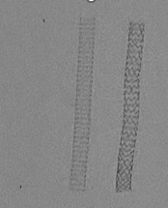
MOTIV BTK Scaffold
Precision Implantation Made Simple
Radiopacity and Single-Step Deployment for Precise Scaffold Placement
Full Radiopacity
Single Step Balloon Inflation
40% Higher Radial Strength
MOTIV
Esprit
MOTIV
Bench testing on 3.0 mm scaffolds in water at 37°C.
Product Instructions for Use
Esprit
MOTIV
Synergy

Slide 5
MOTIV Bioresorbable Scaffold
Randomized Trial
Study Objective:
To evaluate the safety and efficacy of the MOTIV scaffold for the treatment of infrapopliteal lesions in patients with Critical Limb-Threatening Ischemia (CLTI) by randomized comparison with standard balloon angioplasty

Slide 6

MOTIV Bioresorbable Scaffold
BTK Trial Design
Prospective, Multicenter, Single Blind, Randomized Controlled Trial
  MOTIV Sirolimus-Eluting BRS Compared with Standard Balloon Angioplasty
Total of 292 patients presenting with Rutherford category 4 or 5 (CLTI)
  MOTIV BRS Randomized 1:1 with percutaneous transluminal angioplasty (PTA) with a standard uncoated balloon
  Randomized by both clinical site and medically treated diabetes
45 investigational sites across the United States and Europe
  PK substudy up to 20 patients at select US sites
Key Inclusion Criteria
  Rutherford Classification from 4 to 5
  One or Two native infrapopliteal lesions ≥ 70% diameter stenosis
  Target vessels between 2.5 to 3.75mm (initial set)
  Total target lesion is ≤120mm
Follow-up period of 1, 6, 12, 24, 36, 48, and 60 months

Slide 7
MOTIV Bioresorbable Scaffold
Primary Endpoints
Primary Safety Endpoint
  Freedom from major adverse limb events (MALE) and all-cause peri-operative death (POD), evaluated at 30 days
  defined as:
    freedom from the composite of all-cause death,
    above-the-ankle amputation, or
    major reintervention of the index limb involving the infrapopliteal arteries.
Primary Efficacy Endpoint
  Composite of limb salvage and primary patency, evaluated at 1 year
  defined as:
    freedom from above-the-ankle amputation,
    target lesion occlusion,
    clinically driven target lesion revascularization (CD-TLR), or
    binary restenosis of the target lesion.

Slide 8
MOTIV Bioresorbable Scaffold
BTK Trial – Patient Clinical Follow-Up (ITT Population)
Randomized Subjects
N=292
MOTIV BTK Subjects
N=140
Randomization
1:1
PTA Subjects
N=152
Subject Death n= 7
Subject Withdrawn n= 1
Subject LTFU n= 0
Subject Death n= 8
Subject Withdrawn n= 2
Subject LTFU n= 0
MOTIV BTK Subjects
N=132
PTA Subjects
N=142
6-Month Follow-Up
Subject Death n= 3
Subject Withdrawn n= 1
Subject LTFU n= 0
Subject Death n= 2
Subject Withdrawn n= 4
Subject LTFU n= 1
MOTIV BTK Subjects
N=128
1-Year Follow-Up
PTA Subjects
N=135

Slide 9
MOTIV Bioresorbable Scaffold RCT
Key Baseline Demographics and Historical Risk Factors
 | MOTIV BTK | PTA | P-Value
Age | 74.4 ± 10.0 | 73.2 ± 10.6 | 0.35
Male | 76.4% | 77.0% | 0.91
Hypertension (requiring medication) | 88.6% | 89.5% | 0.85
Hyperlipidemia | 84.3% | 78.9% | 0.29
Impaired Renal Function (site reported) | 39.3% | 33.6% | 0.33
CHF | 25.0% | 23.0% | 0.75
History of Smoking | 61.2% | 59.2% | 0.81
Diabetes | 67.9% | 72.4% | 0.44
Prior MI | 19.3% | 15.8% | 0.44
Prior Peripheral Intervention | 45.7% | 42.1% | 0.56
Note: There were no statistically significant differences between arms

Slide 10
MOTIV Bioresorbable Scaffold
BTK Trial –Lesion Characteristics
 | MOTIV BTK | PTA
Type of Lesion
Stenotic Lesion | 68.1% | 70.7%
Total Occlusion | 31.9% | 29.3%
Lesion Length (mm) | 53.8 ± 40.2 (140) | 53.7 ± 45.4 (156)
RVD pre-intervention (mm) | 2.7 ± 0.6 (141) | 2.8 ± 0.7 (156)
Site-Reported Calcification
Focal | 6/147 (4.1%) | 10/161 (6.2%)
Mild | 45/147 (30.6%) | 46/161 (28.6%)
Moderate | 39/147 (26.5%) | 50/161 (31.1%)
% Diameter Stenosis | 73.7 ± 22.1 (141) | 74.1 ± 20.3 (156)
Note: There were no statistically significant differences in Lesion Characteristics noted between the two study arms

Slide 11
MOTIV Bioresorbable Scaffold
Procedural Endpoint
Acute Device Performance
Outcome | MOTIV | PTA | P Value
Device Success | 95.8% (204/213)
Acute Technical Success | 91.5% (129/141) | 72.3% (112/155) | <0.0001
Acute Procedural Success | 89.7% (122/136) | 67.3% (99/147) | <0.0001
Angiographic Acute Gain In-Segment (mm) | 1.69 ± 0.68 | 1.55 ± 0.65 | 0.10
Device Success: Successful delivery and deployment of the study device(s) at the intended target lesion and successful withdrawal of the delivery catheter [evaluated immediately post-procedure].
Acute Technical Success: Achievement of a final residual diameter stenosis <30% by angiography with the assigned device [evaluated immediately post-procedure].
Acute Procedure Success: Acute technical success and absence of major adverse events (MAE) defined as death, stroke, MI, acute onset of limb ischemia, index bypass graft or treated segment thrombosis, and/or need for urgent/emergent vascular surgery) within 72 hours of the index procedure [evaluated in-hospital] in the absence of clinically driven bailout device use.

Slide 12
MOTIV Bioresorbable Scaffold
Primary Safety Endpoint
Freedom from MALE + POD at 30 days
Endpoint/Component | MOTIV | PTA | Difference (95% CI) | P-value¹
Freedom from MALE + POD ITT | 99.3% (133 / 134) | 98.6% (145 / 147) | -0.6% (-5.2%, 4.0%) | 0.0003
POD (All-Cause Death) | 0.0% (0 / 133) | 0.0% (0 / 146)
Above-the-ankle amputation | 0.0% (0 / 133) | 0.0% (0 / 146)
Major re-intervention | 0.7% (1 / 134) | 1.4% (2 / 147)
Freedom from MALE + POD PP | 99.2% (128 / 129) | 98.6% (142 / 144) | -0.6% (-5.3%, 4.0%) | 0.0004
Early safety was preserved, with no peri-operative deaths and no above-the-ankle amputations in either arm and very low major reintervention rates overall.
¹ Two-sided 95% confidence intervals for the difference between groups using the Farrington-Manning approach. Corresponding 1-sided p-value using Farrington-Manning compared to a non-inferiority margin of 8%.

Slide 13
MOTIV Bioresorbable Scaffold
Primary Efficacy Endpoint
Composite of limb salvage and primary patency at 1 year – ITT population
Comparison | MOTIV | PTA | Difference (95% CI) | P-value¹
Primary Efficacy Endpoint | 70% (79/113) | 48% (60/124) | 22% (9%, 34%) | 0.0003
Primary efficacy was superior with MOTIV, representing a 22% absolute risk difference
Secondary Endpoint: Composite of limb salvage and primary patency at 6 months
Comparison | MOTIV | PTA | Difference (95% CI) | P-value¹
Secondary Efficacy Endpoint | 81% (98 / 121) | 62% (82 / 133) | 19% (9% to 30%) | 0.0005
Superiority over PTA evident by 6 months, supporting an early and clinically meaningful benefit
¹ Two-sided 95% confidence intervals for the difference between groups using the normal approximation with unpooled variance.
Corresponding 1-sided p-value from the Z-test with unpooled variance.

Slide 14
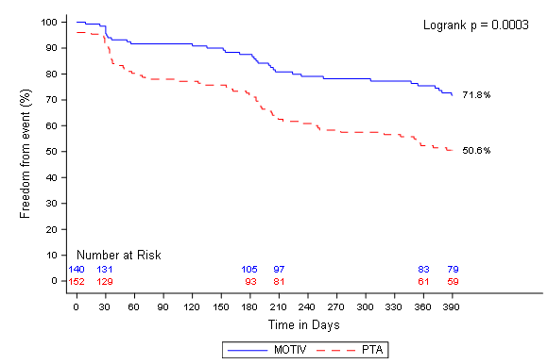
MOTIV Bioresorbable Scaffold
Primary Efficacy Endpoint – Kaplan Meier Estimates
Comparison | MOTIV | PTA | Difference (95% CI) | P-value¹
Primary Efficacy Endpoint | 70% (79/113) | 48% (60/124) | 22% (9%, 34%) | 0.0003
Primary Patency Values (ARD)
Kaplan Meier Estimates of Primary Efficacy based upon:
- freedom from above-the-ankle amputation
- target lesion occlusion,
- clinically driven target lesion revascularization (CD-TLR),
or
- binary restenosis of the target lesion.
¹ Two-sided 95% confidence intervals for the difference between groups using the normal approximation with unpooled variance. Corresponding 1-sided p-value from the Z-test with unpooled variance. Patient DUS visit censored at end of visit window (Day 390)

Slide 15
MOTIV Bioresorbable Scaffold
BTK Trial Conclusions
MOTIV primary efficacy endpoint of Limb Salvage & Primary Patency found to be clearly superior at 12 months with a 22% absolute risk difference when compared to PTA
  Trial included more complex patients than prior Bioresorbable Scaffold BTK trials
    Higher average of 68.5% Rutherford 5 patients as compared to LIFE BTK at 48.2%
    Modestly longer lesion of average 54mm as compared to 44mm as compared to LIFE BTK
    Over 30% of enrolled patients presented with Total Occlusions
MOTIV BTK study observed no decrease in patency results with lesions >60mm
Early clinical benefit established with superiority demonstrated as early as 6 months
Safety established throughout follow-up with non-inferiority to PTA

